Slide 1

INFO 6150
WEB DESIGN AND USER EXPERIENCE ENGINEERING
HELP ON THE GO
AUTHORS
PRANJAL GUPTA – 001094676
MRIDUL REGMI – 001090410
UDAY SIDDHARTH K S - 002192624
NIDHI RAGHAVENDRA - 002193886

Slide 2
PURPOSE
A web application that aims to provide a platform to advertise your skills and job qualifications or look for someone who could do the job for you!
Need a website for your upcoming business?
Hire a web developer in a few clicks through Help-on-the-go!
Have a marketable skill and want to make a few extra bucks?
Sign up and join our community to help people while you make your money!
Need help with setting up your new home?
Worry not! Help-on-the-go has a rapidly diverse community providing you help with almost anything!
Wanna collaborate with skilled people?
Why not? Help-on-the-go brings together many smart people of similar interests!

Slide 3
User flow
Registration | Join our community
Add skills and qualifications
Set the price
Set the feasible locations of work
Chat with them!
Update the availability
Reward the person with a 5-star rating
Look for people who can do the work for you

Slide 4
CONTRIBUTIONS
MRIDUL REGMI – INTEGRATION WITH CHAT-ENGINE APIS, CHAT INTERFACE – MVC, MONGO DB ATLAS, SEEK PAGE BACKEND, BOOKING PLACEMENT FLOW, BOOKING HISTORY FOR HELPER ROLE - MVC, SKILL SEARCH BACKEND, ROUTING
PRANJAL GUPTA – STRUCTURE SERVER-SIDE CODE, USER PROFILE PAGE – MVC, CRUD FOR SKILLS & DOMAINS, GENERATE AVERAGE RATING AND REVIEWS FOR HELPER, ENTIRE REVIEW FUNCTIONALITY – MVC, BACKEND FOR ORDER HISTORY FOR HELPER, POPULATE CARDS IN LANDING PAGE, DATA PREPARATION, ATLASSIAN SET UP, MATERIAL UI, ROUTING
UDAY SIDDHARTH K S – MAILER API, SEEK PAGE, LOCATION API, BOOKING PAGE – (VC), BOOKING HISTORY PAGE FOR SEEKER, BOOTSTRAP, ROUTING
NIDHI RAGHAVENDRA – PROJECT STRUCTURING – CLIENT & SERVER, LOGO, CUSTOM SCSS FOR UI/UX - LANDING PAGE & FIXED LAYOUTS JOIN, SIGN-UP & REGISTRATION, MULTER, ROLE-BASED ACCESS, REACT REDUX, BROWSER ROUTER, MATERIAL UI & BOOSTRAP FOR FORM ELEMENTS, JWT AUTHENTICATION
THE TEAM CONTRIBUTED TO THE DATABASE MODELING, GIT, APPLICATION APIs FOR PROJECT FUNCTIONALITIES

Slide 5


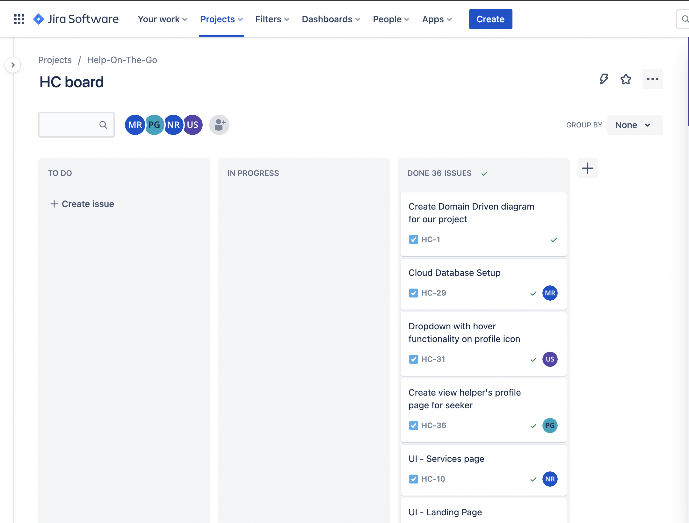




Slide 6


Slide 7


Slide 8
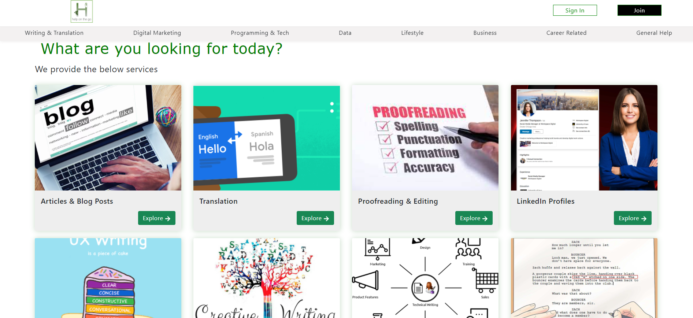

Slide 9
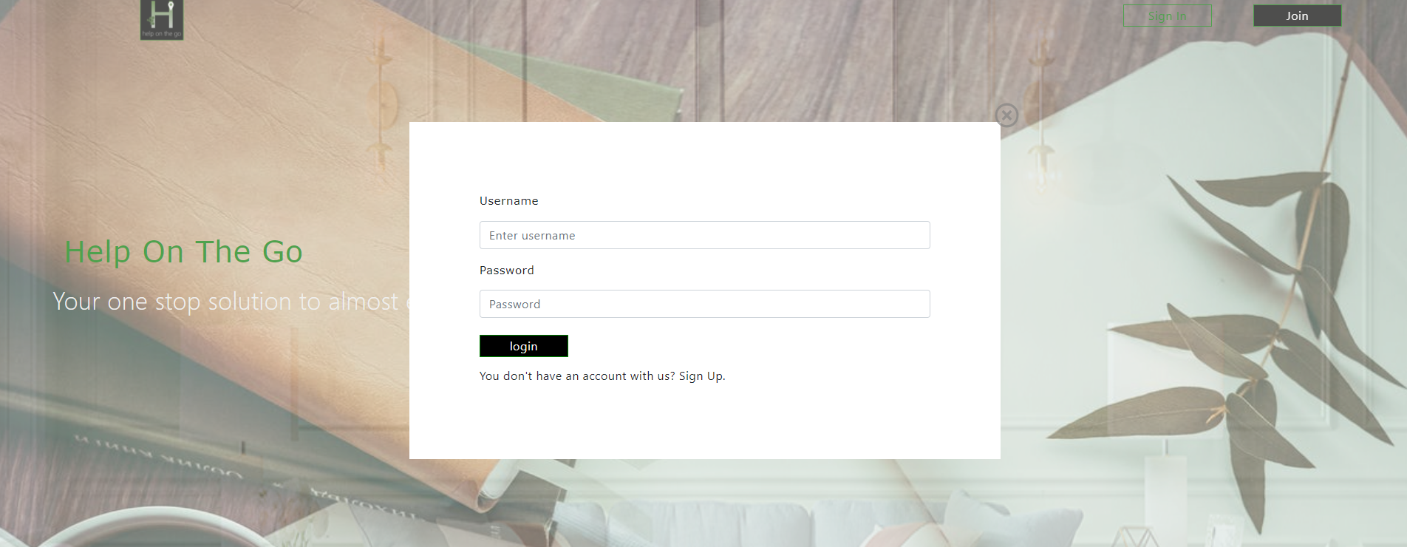

Slide 10
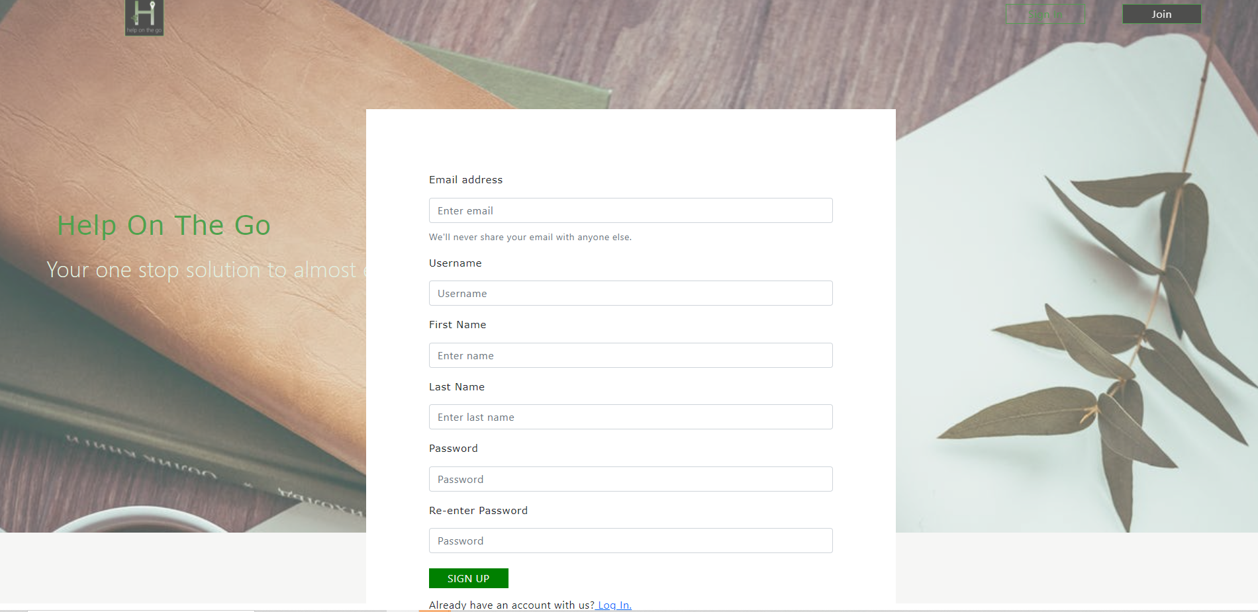

Slide 11
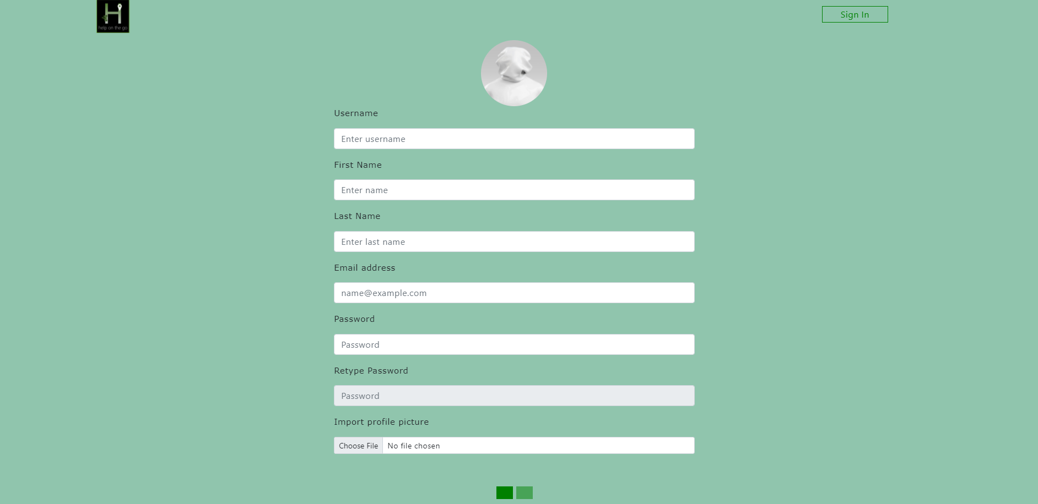

Slide 12
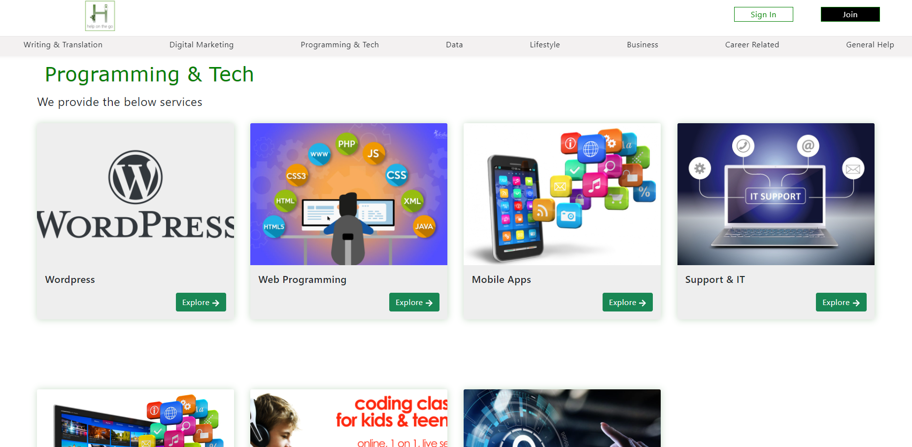

Slide 13
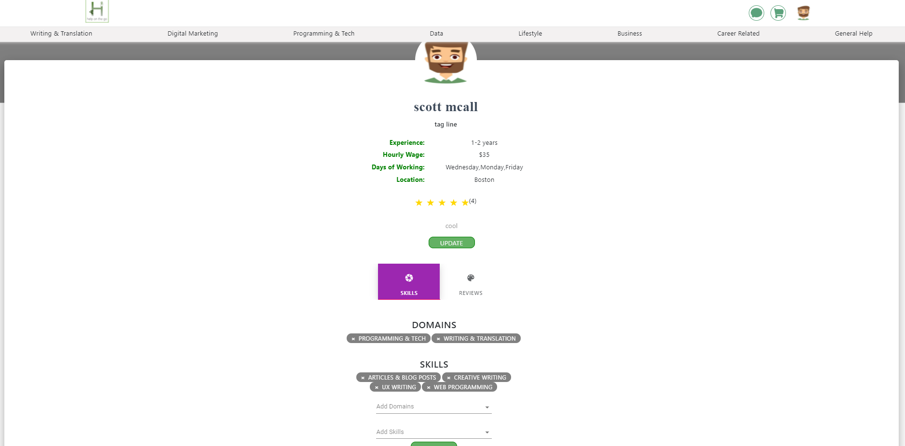

Slide 14
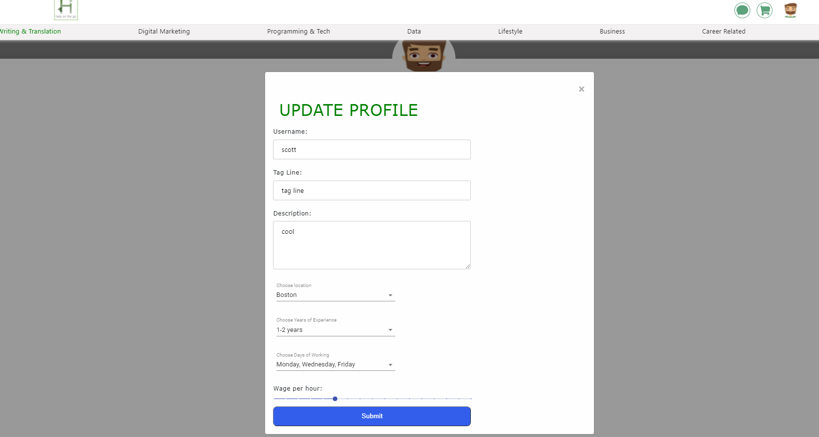

Slide 15
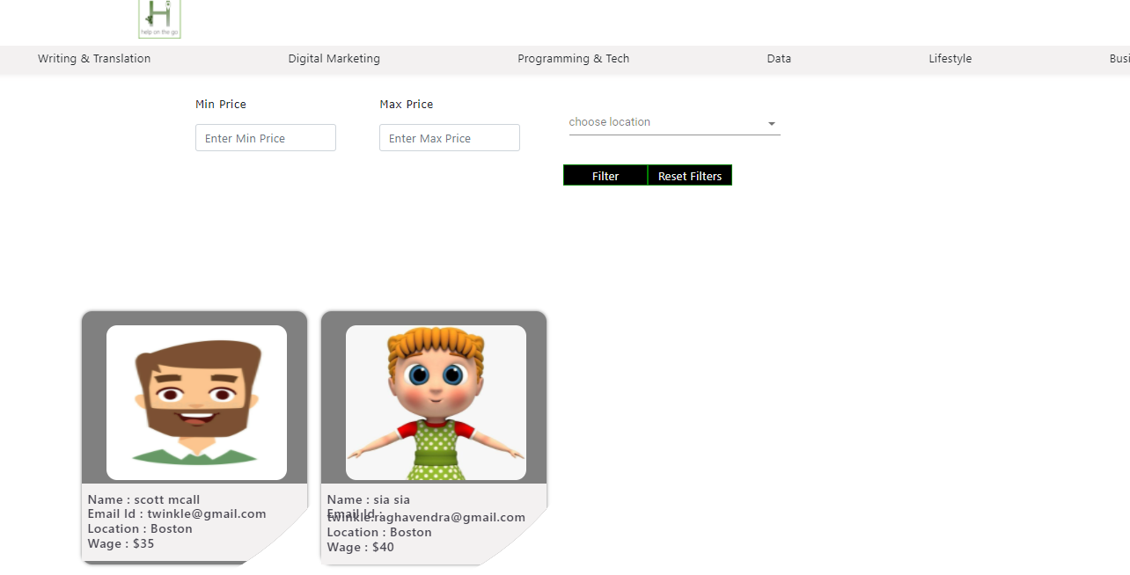

Slide 16
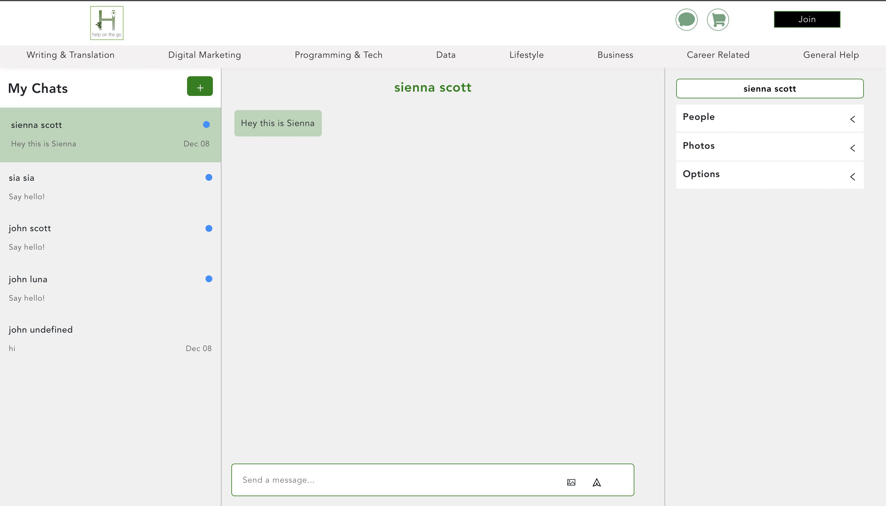

Slide 17
